Slide 1
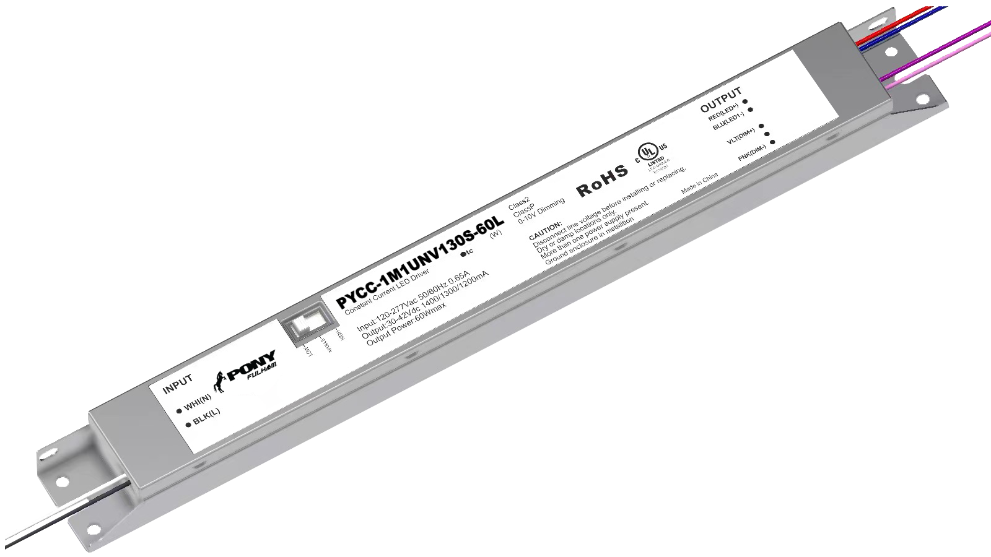
Pony Selectable Current (PYCC)
7 Models: release date end of May
Applications: Indoor - Office
Class 2 output
cULus listed, Class P
Selectable Current, three preset currents per model (50mA intervals)
0-10V dimmable from 100%-10%
Linear form factor with wires
IP20 rating
EMI: FCC Title 47 Part 15B
Input Surge Protection: Line-Neutral 1kV, Line & Neutral-Ground 2kV, RingWave 2.5kV
Ambient Temperature: -25°C - 50°C
Warranty: 5 years @ Tc 90°C from the date of manufacture
Part Number | Max Output Power | Input Voltage | Output Voltage Range (VDC) | Selectable Current Range (mA) | 0-10V Dimming Range | Typical Efficiency at Max Load | Dimensions (inches)
 |  |  |  |  |  |  | L | W | H
PYCC-1M1UNV040S-20L | 20W | 120-277VAC | 30~42Vdc | 300 / 350 / 400 | 100-10% | 86% | 11.02” | 1.18” | 0.83”
PYCC-1M1UNV055S-30L | 30W | 120-277VAC | 30~42Vdc | 450 / 500 / 550 | 100-10% | 86% | 11.02” | 1.18” | 0.83”
PYCC-1M1UNV070S-30L | 30W | 120-277VAC | 30~42Vdc | 600 / 650 / 700 | 100-10% | 86% | 11.02” | 1.18” | 0.83”
PYCC-1M1UNV085S-40L | 40W | 120-277VAC | 30~42Vdc | 750 / 800 / 850 | 100-10% | 86% | 11.02” | 1.18” | 0.83”
PYCC-1M1UNV100S-40L | 40W | 120-277VAC | 30~42Vdc | 900 / 950 / 1000 | 100-10% | 86% | 11.02” | 1.18” | 0.83”
PYCC-1M1UNV115S-50L | 50W | 120-277VAC | 30~42Vdc | 1050 / 1100 / 1150 | 100-10% | 86% | 11.02” | 1.18” | 0.83”
PYCC-1M1UNV130S-60L | 60W | 120-277VAC | 30~42Vdc | 1200 / 1250 / 1300 | 100-10% | 86% | 11.02” | 1.18” | 0.83”

